Slide 1
Chapter 3
Loaders and Linkers
Assembler
Linker
Source
Program
Object
Code
Executable
Code
Loader

Slide 2
Introduction
To execute an object program, we needs
  Relocation, which modifies the object program so that it can be loaded at an address different from the location originally specified
  Linking, which combines two or more separate object programs and supplies the information needed to allow references between them
  Loading and Allocation, which allocates memory location and brings the object program into memory for execution

Slide 3
3.1 Basic Loader Functions
In Chapter 2, we discussions
  Loading: brings the OP into memory for execution
  Relocating: modifies the OP so that it can be loaded at an address different form the location originally specified.
  Linking: combines two or more separate OP
In Chapter 3, we will discussion
  A loader brings an object program into memory and starting its execution.
  A linker performs the linking operations and a separate loader to handle relocation and loading.

Slide 4
Loaders
Type of loaders
  assemble-and-go loader
  absolute loader (bootstrap loader)
  relocating loader (relative loader)
  direct linking loader
Design options
  linkage editors
  dynamic linking
  bootstrap loaders

Slide 5
Assemble-and-go Loader
Characteristic
  the object code is stored in memory after assembly
  single JUMP instruction
Advantage
  simple, developing environment
Disadvantage
  whenever the assembly program is to be executed, it has to be assembled again
  programs have to be coded in the same language

Slide 6
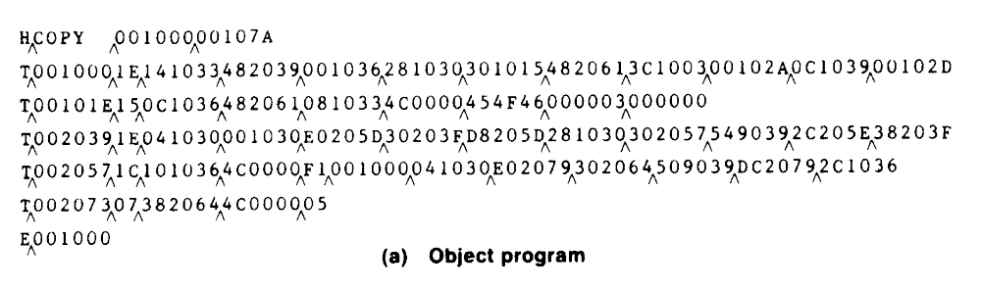
3.1 Basic Loader Functions
3.1.1 Design of an Absolute Loader
Absolute loader, in Figures 3.1 and 3.2.
  Does not perform linking and program relocation.
  The contents of memory locations for which there is no Text record are shown as xxxx.
  Each byte of assembled code is given using its Hex representation in character form.

Slide 7
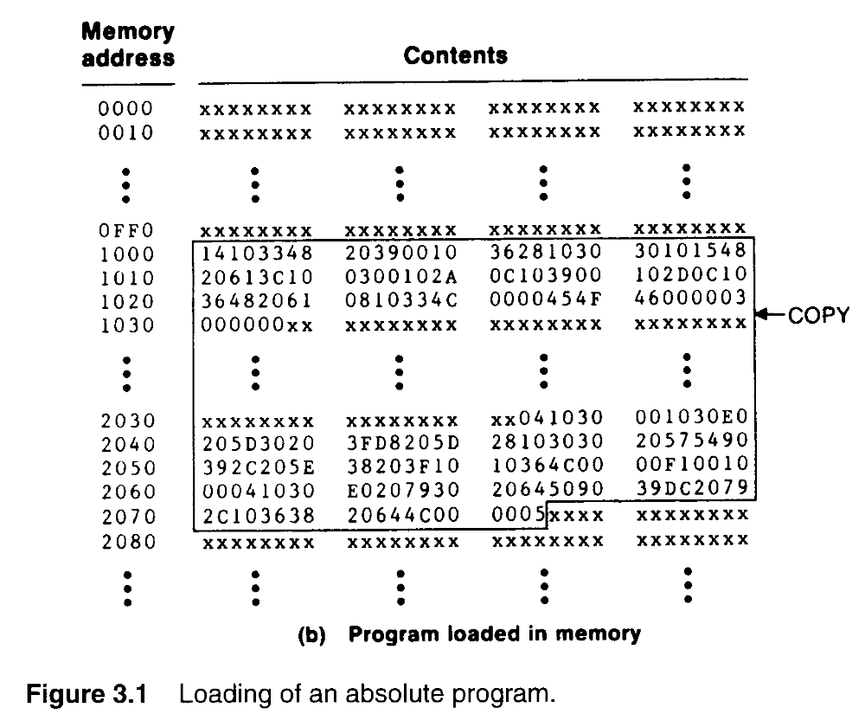

Slide 8
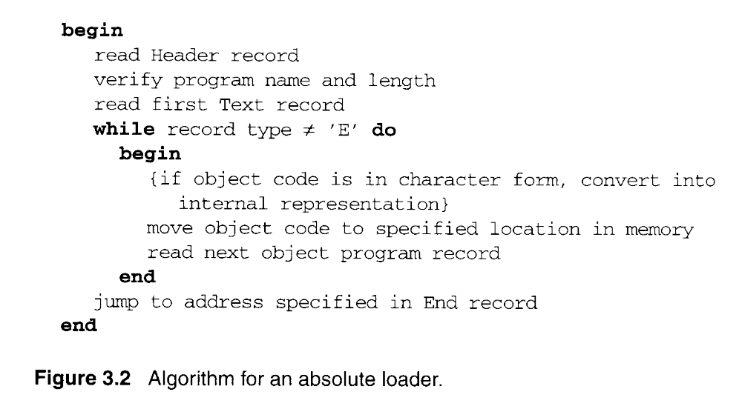
Fig. 3.2 Algorithm for an absolute loader

Slide 9
3.1.1 Design of an Absolute Loader
Absolute loader, in Figure 3.1 and 3.2.
  STL instruction, pair of characters 14, when these are read by loader, they will occupy two bytes of memory.
  14 (Hex 31 34) ----> 00010100 (one byte)
  For execution, the operation code must be store in a single byte with hexadecimal value 14.
  Each pair of bytes must be packed together into one byte.
  Each printed character represents one half-byte.

Slide 10
Object Code Representation
Figure 3.1 (a)
  each byte of assembled code is given using its hexadecimal representation in character form
  easy to read by human beings
In general
  each byte of object code is stored as a single byte
  most machine store object programs in a binary form
  we must be sure that our file and device conventions do not cause some of the program bytes to be interpreted as control characters

Slide 11
3.1.2 A Simple Bootstrap Loader
Bootstrap Loader
  When a computer is first tuned on or restarted, a special type of absolute loader, called bootstrap loader is executed
  This bootstrap loads the first program to be run by the computer -- usually an operating system
Example (SIC bootstrap loader)
  The bootstrap itself begins at address 0
  It loads the OS starting address 0x80
  No header record or control information, the object code is consecutive bytes of memory

Slide 12
3.1.2 A Simple Bootstrap Loader
A bootstrap loader, Figure 3.3.
  Each byte of object code to be loaded is represented on device F1 as two Hex digits (by GETC subroutines).
  The ASCII code for the character 0 (Hex 30) is converted to the numeric value 0.
  The object code from device F1 is always loaded into consecutive bytes of memory, starting at address 80.

Slide 13
Fig. 3.3 SIC Bootstrap Loader Logic
Begin
X=0x80 (the address of the next memory location to be loaded
Loop
A←GETC (and convert it from the ASCII character code to the value of the hexadecimal digit)
save the value in the high-order 4 bits of S
A←GETC
combine the value to form one byte A← (A+S)
store the value (in A) to the address in register X
X←X+1
End
0~9 : 30~39
A~F : 41~46
GETC A←read one character
if A=0x04 then jump to 0x80
if A<48 then GETC
A ← A-48 (0x30)
if A<10 then return
A ← A-7
return

Slide 14
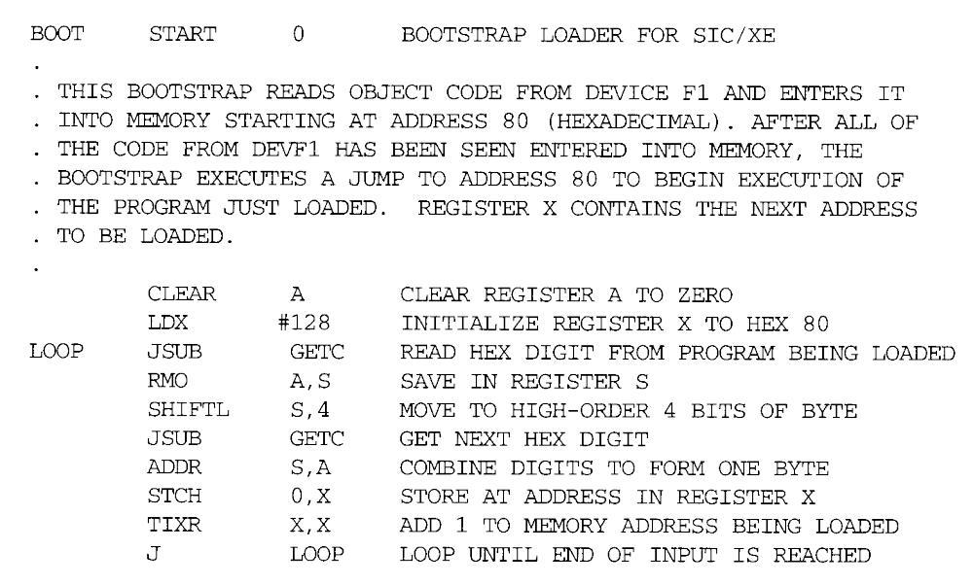

Slide 15
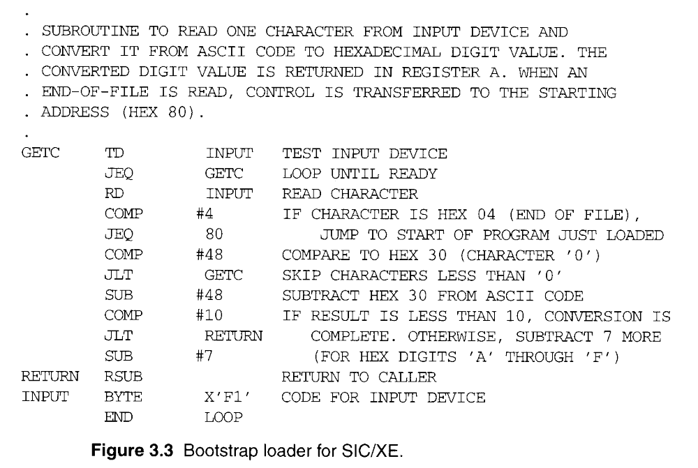

Slide 16
3.2 Machine-Dependent Loader Features
Absolute loader has several potential disadvantages.
  The actual address at which it will be loaded into memory.
  Cannot run several independent programs together, sharing memory between them.
  It difficult to use subroutine libraries efficiently.
More complex loader.
  Relocation
  Linking
  Linking loader

Slide 17
Relocating Loaders
Motivation
  efficient sharing of the machine with larger memory and when several independent programs are to be run together
  support the use of subroutine libraries efficiently
Two methods for specifying relocation
  modification record (Fig. 3.4, 3.5)
  relocation bit (Fig. 3.6, 3.7)
    each instruction is associated with one relocation bit
    these relocation bits in a Text record is gathered into bit masks

Slide 18
3.2.1 Relocation
Relocating loaders, two methods:
  Modification record (for SIC/XE)
  Relocation bit (for SIC)
Modification record
  col 1: M
  col 2-7: relocation address
  col 8-9: length (halfbyte)
  col 10: flag (+/-)
  col 11-17: segment name

Slide 19
Fig. 3.5
H_{Λ}COPY _{Λ}000000 001077
T_{Λ}000000 _{Λ}1D_{Λ}17202D_{Λ}69202D_{Λ}48101036_{Λ}032026_{Λ}..._{Λ}3F2FEC_{Λ}032010
T_{Λ}00001D_{Λ}13_{Λ}0F2016_{Λ}010003_{Λ}0F200D_{Λ}4B10105D_{Λ}3E2003_{Λ}454F46
T_{Λ}001035 _{Λ}1D_{Λ}B410_{Λ}B400_{Λ}B440_{Λ}75101000_{Λ}E32019_{Λ}..._{Λ}57C003_{Λ}B850
T_{Λ}001053_{Λ}1D_{Λ}3B2FEA_{Λ}134000_{Λ}4F0000_{Λ}F1_{Λ}B410_{Λ}..._{Λ}DF2008_{Λ}B850
T_{Λ}00070_{Λ}07_{Λ}3B2FEF_{Λ}4F0000_{Λ}05
M_{Λ}000007_{Λ}05+COPY
M_{Λ}000014_{Λ}05+COPY
M_{Λ}000027_{Λ}05+COPY
E_{Λ}000000

Slide 20
Relocation Bit
For simple machines
Relocation bit
  0: no modification is necessary
  1: modification is needed
Twelve-bit mask is used in each Text record
  since each text record contains less than 12 words
  unused words are set to 0
  any value that is to be modified during relocation must coincide with one of these 3-byte segments
    e.g. line 210
Text record
  col 1: T
  col 2-7: starting address
  col 8-9: length (byte)
  col 10-12: relocation bits
  col 13-72: object code

Slide 21
Fig. 3-7
H_{Λ}COPY _{Λ}000000 00107A
T_{Λ}000000_{Λ}1E_{Λ}FFC_{Λ}140033_{Λ}481039_{Λ}000036_{Λ}280030_{Λ}300015_{Λ}481061_{Λ}…
T_{Λ}00001E_{Λ}15_{Λ}E00_{Λ}0C0036_{Λ}481061_{Λ}080033_{Λ}4C0000_{Λ}454F46_{Λ}000003_{Λ}000000
T_{Λ}001039_{Λ}1E_{Λ}FFC_{Λ}040030_{Λ}000030_{Λ}E0105D_{Λ}30103F_{Λ}D8105D_{Λ}280030_{Λ}...
T_{Λ}001057_{Λ}0A_{Λ} 800_{Λ}100036_{Λ}4C0000_{Λ}F1_{Λ}001000
T_{Λ}001061_{Λ}19_{Λ}FE0_{Λ}040030_{Λ}E01079_{Λ}301064_{Λ}508039_{Λ}DC1079_{Λ}2C0036_{Λ}...
E_{Λ}000000

Slide 22
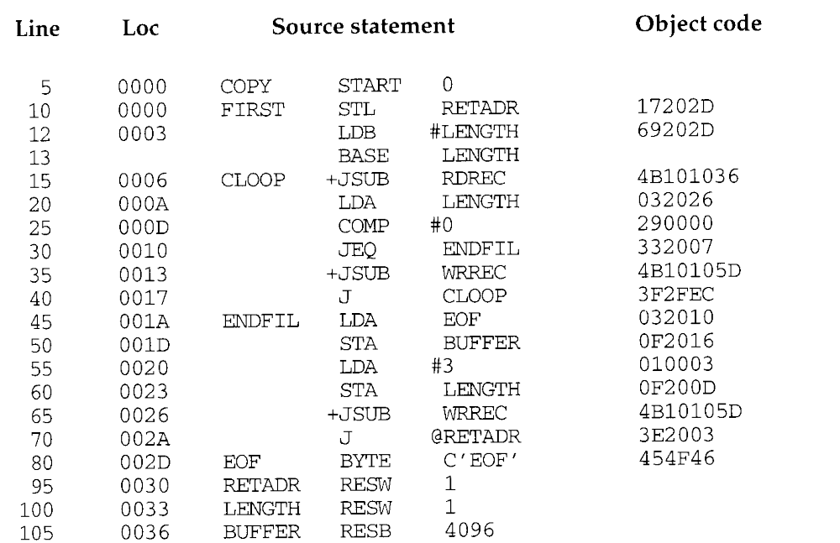

Slide 23
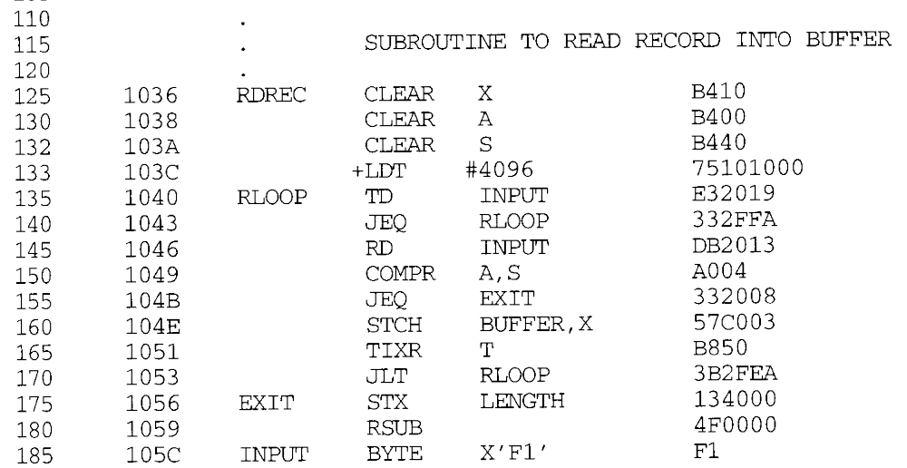

Slide 24
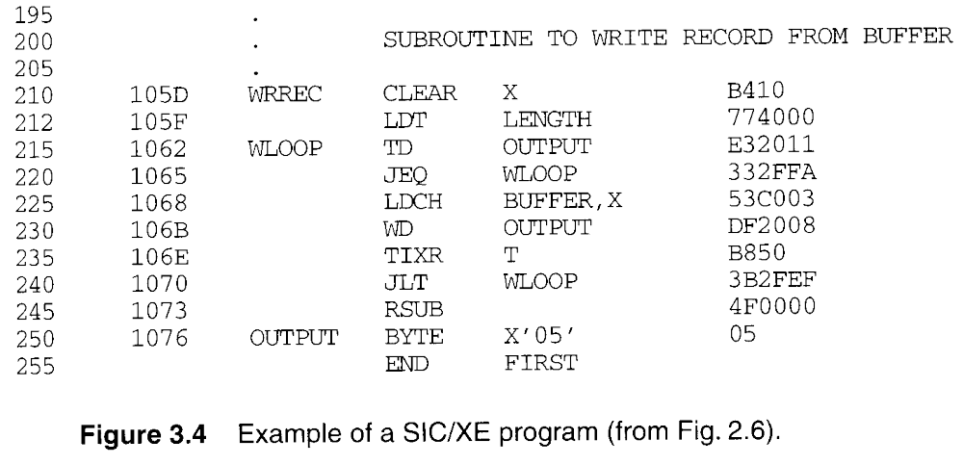

Slide 25
3.2.1 Relocation
Modification record, Figure 3.4 and 3.5.
  To described each part of the object code that must be changed when the program is relocated.
  The extended format instructions on lines 15, 35, and 65 are affected by relocation. (absolute addressing)
  In this example, all modifications add the value of the symbol COPY, which represents the starting address.
  Not well suited for standard version of SIC, all the instructions except RSUB must be modified when the program is relocated. (absolute addressing)

Slide 26
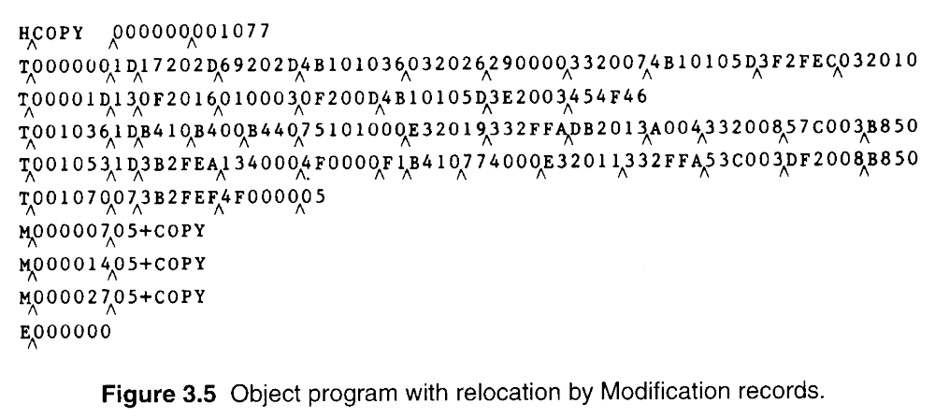

Slide 27
3.2.1 Relocation
Figure 3.6 needs 31 Modification records.
Relocation bit, Figure 3.6 and 3.7.
  A relocation bit associated with each word of object code.
  The relocation bits are gathered together into a bit mask following the length indicator in each Text record.
  If bit=1, the corresponding word of object code is relocated.

Slide 28
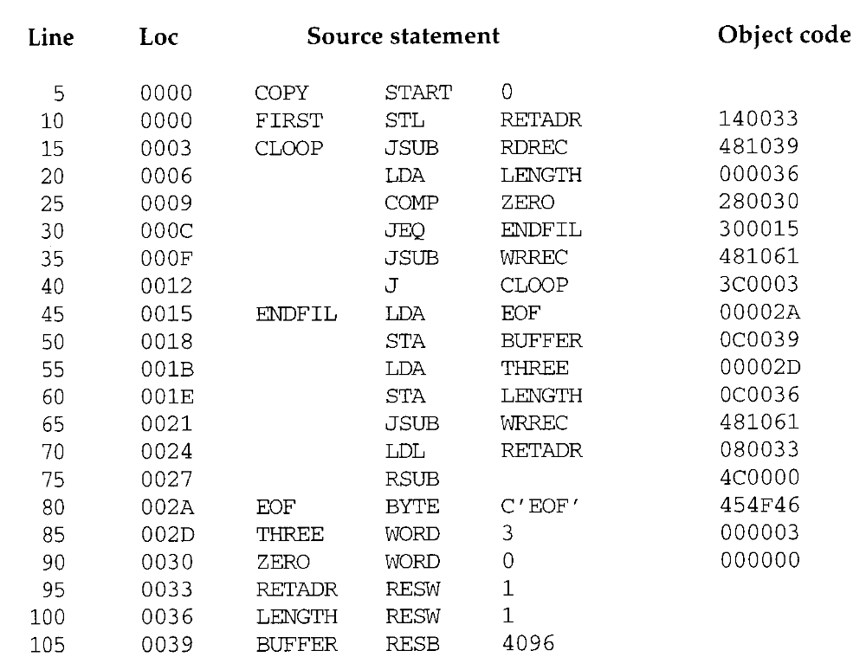

Slide 29
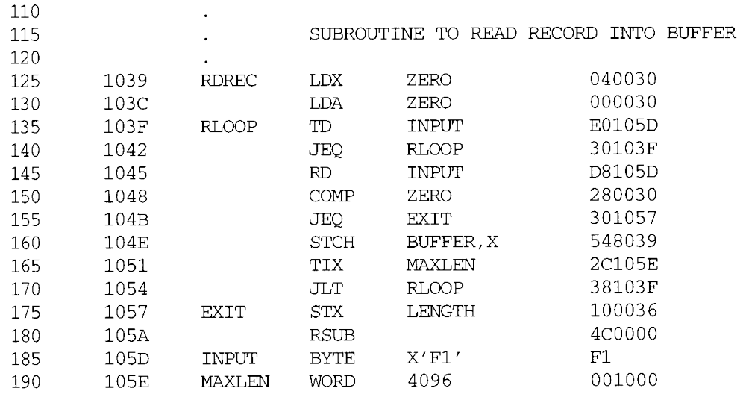

Slide 30
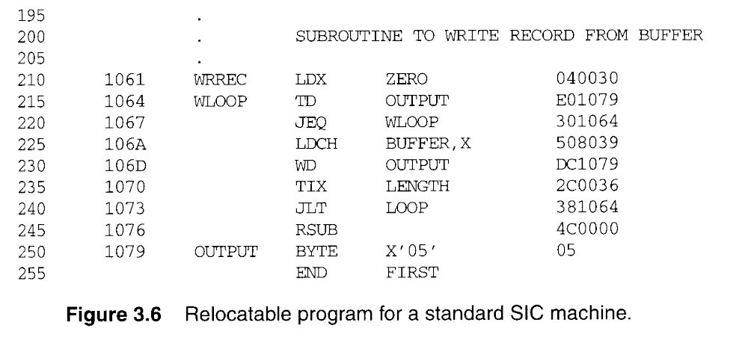

Slide 31
3.2.1 Relocation
Relocation bit, Figure 3.6 and 3.7.
  In Figure 3.7, T000000^1E^FFC^ (111111111100) specifics that all 10 words of object code are to be modified.
  On line 210 begins a new Text record even though there is room for it in the preceding record.
  Any value that is to be modified during relocation must coincide with one of these 3-byte segments so that it corresponding to a relocation bit.
  Because of the 1-byte data value generated form line 185, this instruction must begin a new Text record in object program.

Slide 32
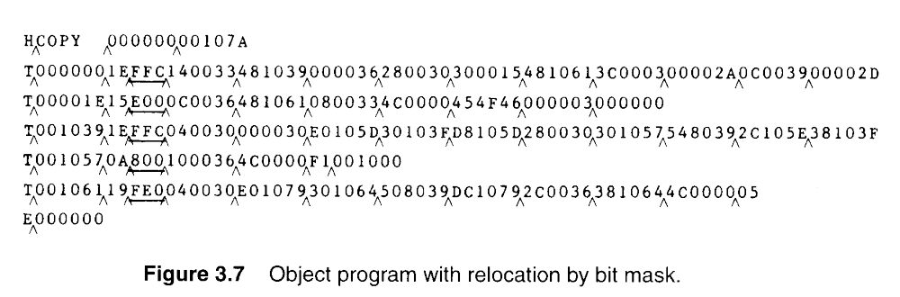
1111 1111 1100

Slide 33
3.2.2 Program Linking
In Section 2.3.5 showed a program made up of three controls sections.
  Assembled together or assembled independently.

Slide 34
3.2.2 Program Linking
Consider the three programs in Fig. 3.8 and 3.9.
  Each of which consists of a single control section.
  A list of items, LISTA---ENDA, LISTB---ENDB, LISTC---ENDC.
  Note that each program contains exactly the same set of references to these external symbols.
  Instruction operands (REF1, REF2, REF3).
  The values of data words (REF4 through REF8).
  Not involved in the relocation and linking are omitted.

Slide 35
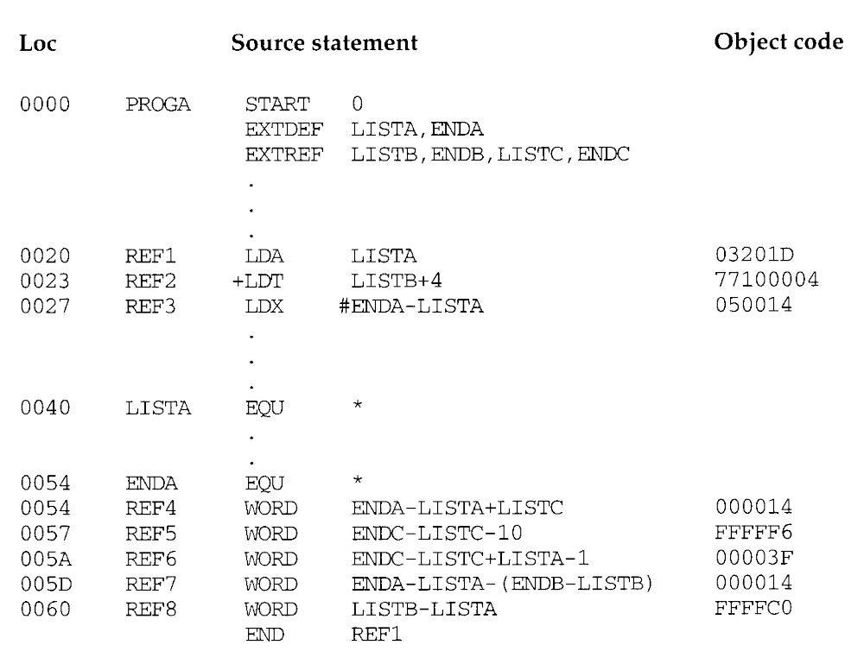

Slide 36
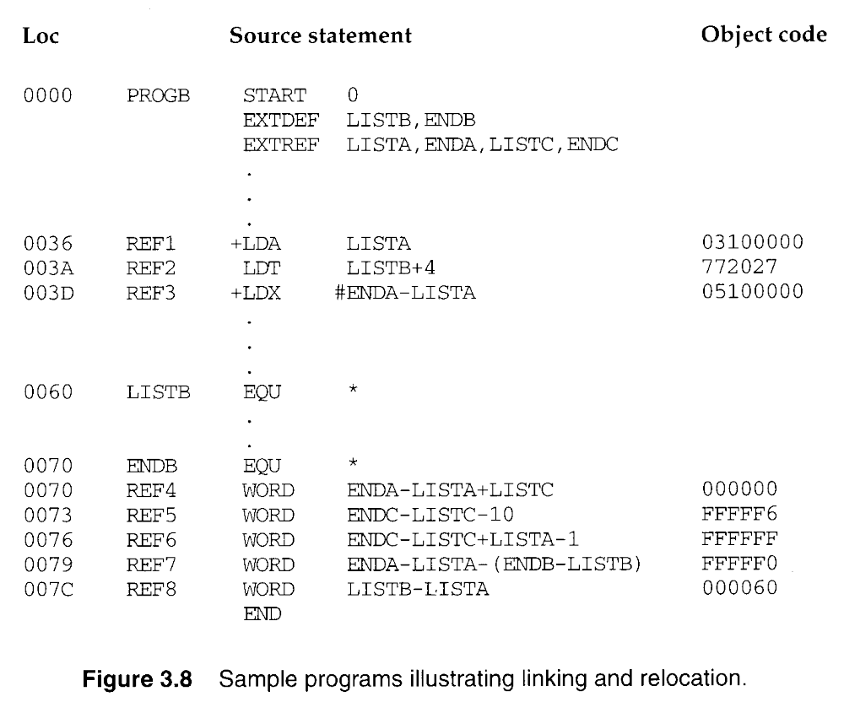

Slide 37
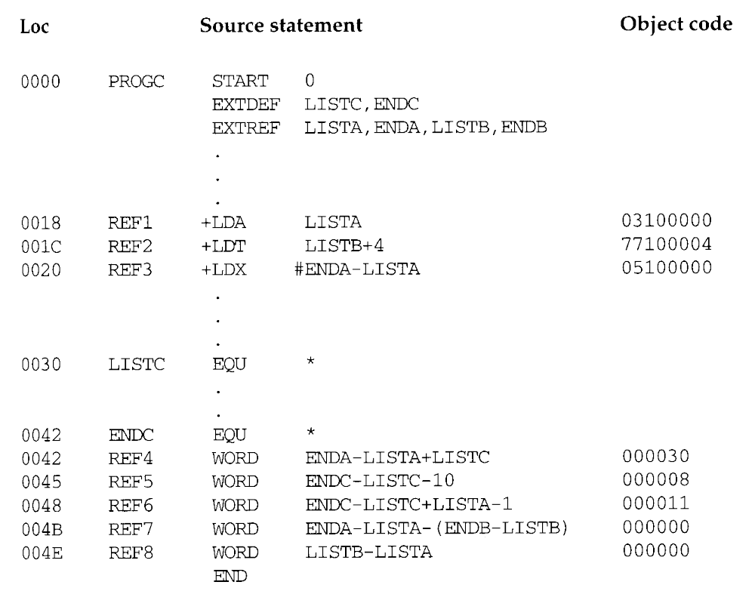

Slide 38
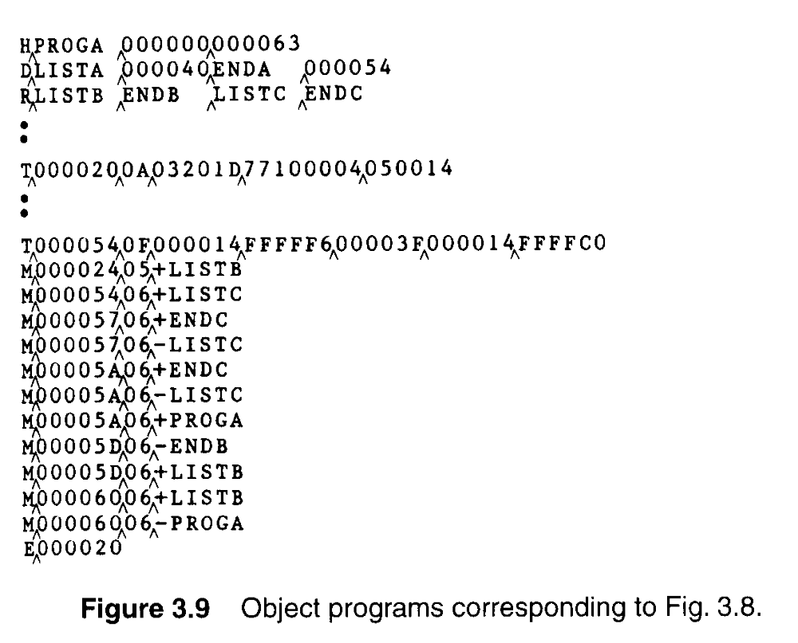

Slide 39
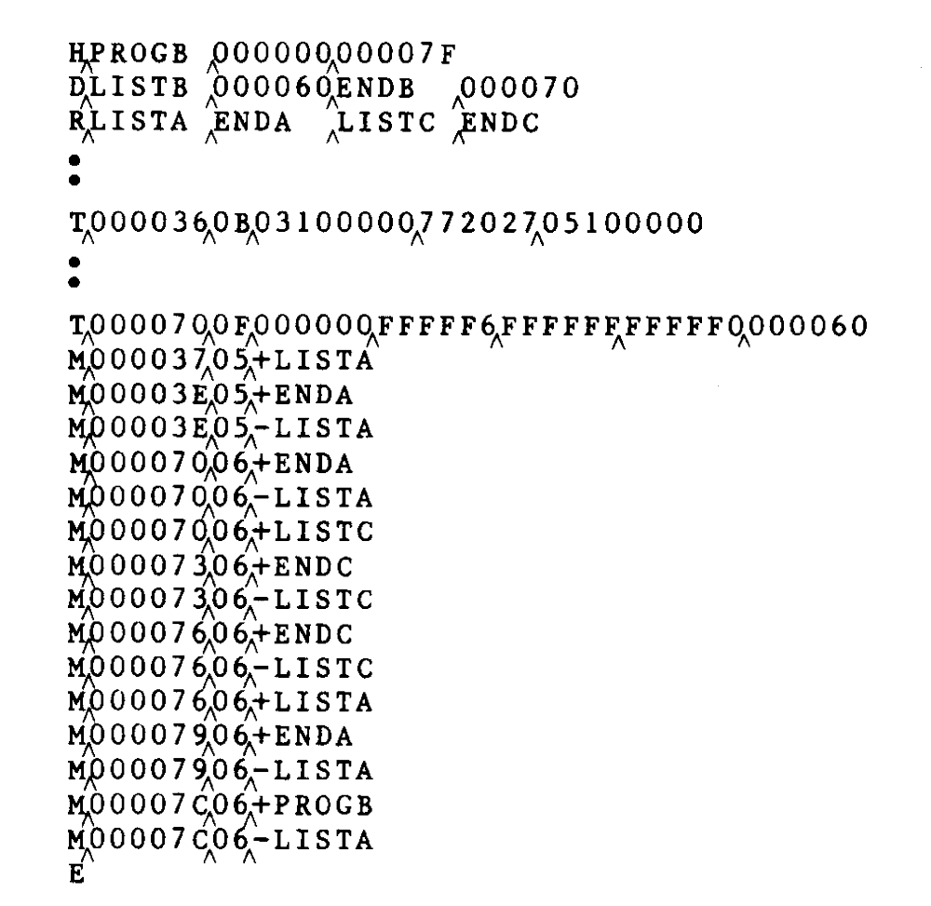

Slide 40
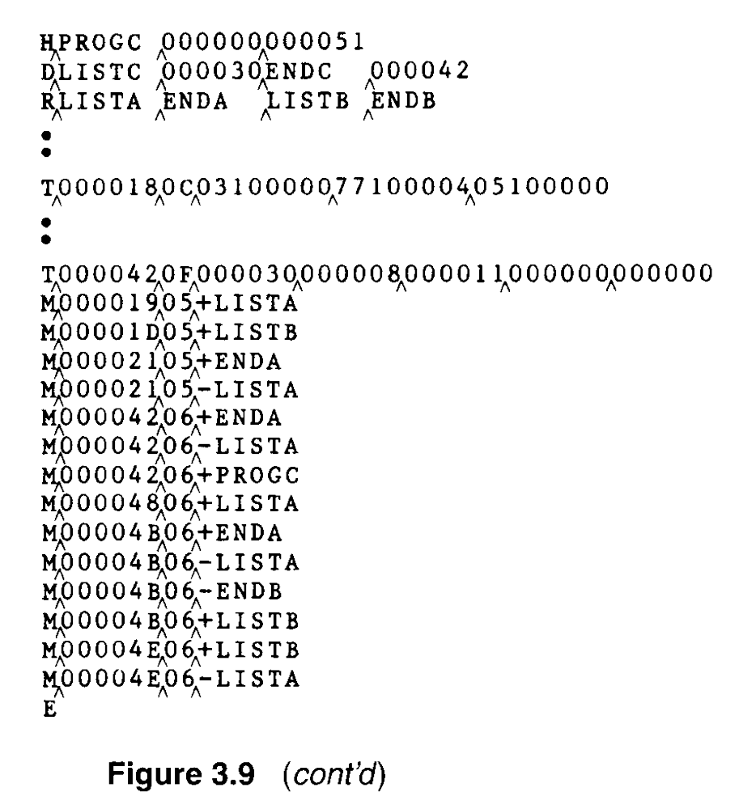

Slide 41
3.2.2 Program Linking
REF1, LDA LISTA 03201D 03100000
  In the PROGA, REF1 is simply a reference to a label.
  In the PROGB and PROGC, REF1 is a reference to an external symbols.
  Need use extended format, Modification record.
REF2 and REF3.
  LDT LISTB+4 772027 77100004
  LDX #ENDA-LISTA 050014 05100000

Slide 42
3.2.2 Program Linking
REF4 through REF8,
  WORD ENDA-LISTA+LISTC 000014+000000
Figure 3.10(a) and 3.10(b)
  Shows these three programs as they might appear in memory after loading and linking.
  PROGA 004000, PROGB 004063, PROGC 0040E2.
  REF4 through REF8 in the same value.
  For the references that are instruction operands, the calculated values after loading do not always appear to be equal.
  Target address, REF1 4040.

Slide 43
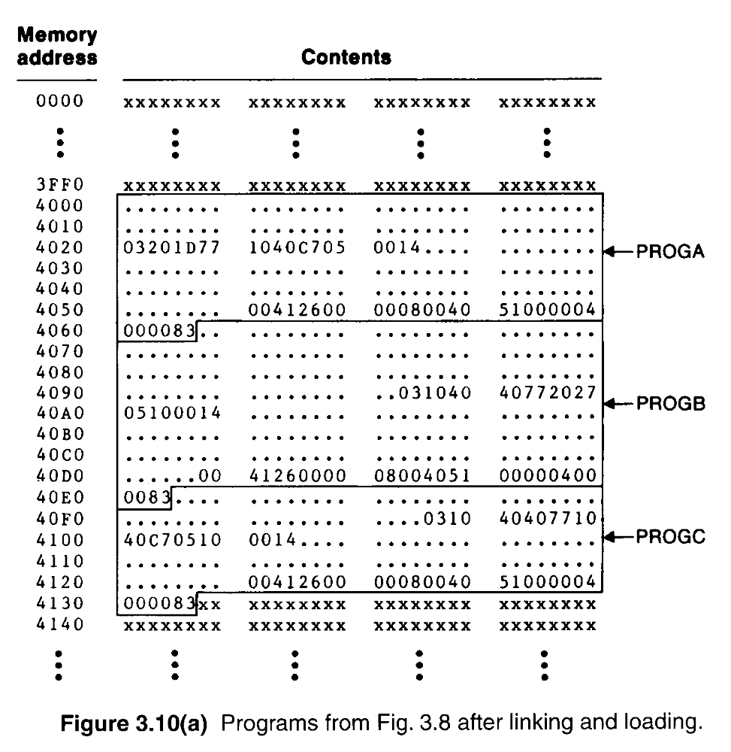

Slide 44
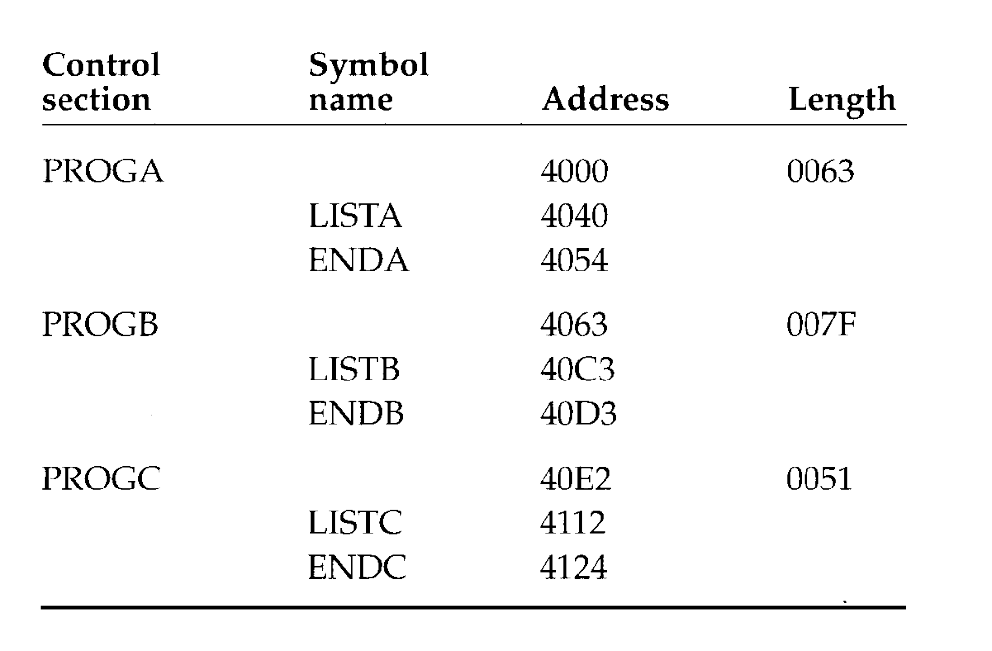

Slide 45
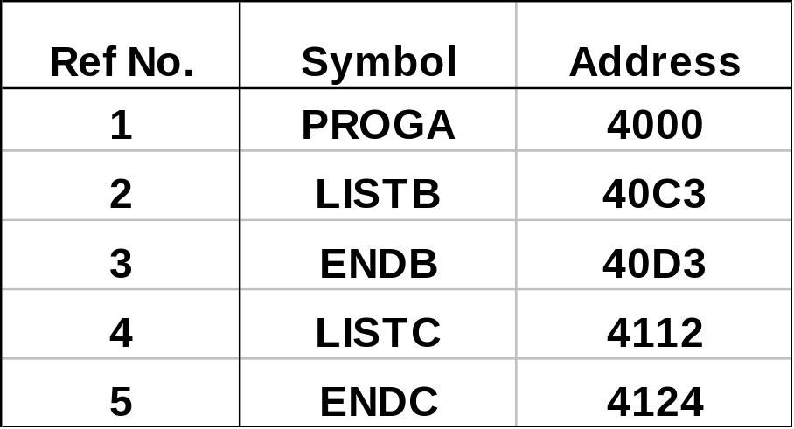

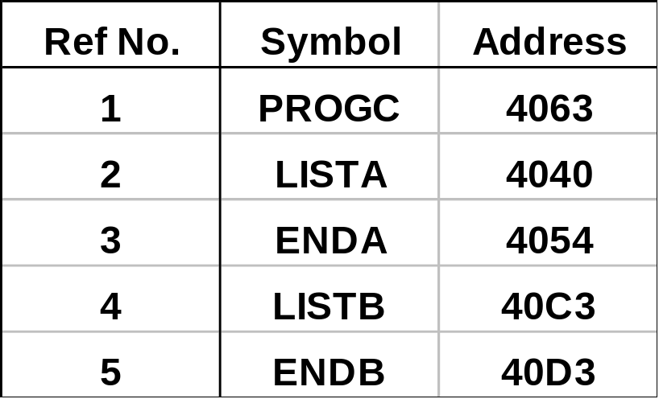

Slide 46
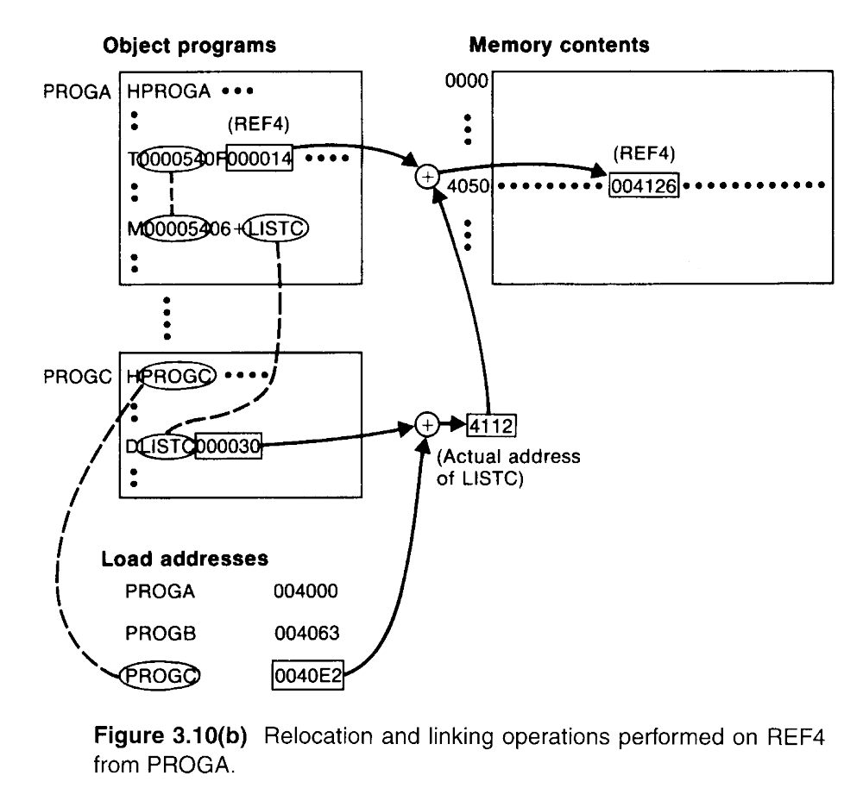

Slide 47
3.2.3 Algorithm and Data Structure for a Linking Loader
A linking loader usually makes two passes
  Pass 1 assigns addresses to all external symbols.
  Pass 2 performs the actual loading, relocation, and linking.
  The main data structure is ESTAB (hashing table).

Slide 48
3.2.3 Algorithm and Data Structure for a Linking Loader
A linking loader usually makes two passes
  ESTAB is used to store the name and address of each external symbol in the set of control sections being loaded.
  Two variables PROGADDR and CSADDR.
  PROGADDR is the beginning address in memory where the linked program is to be loaded.
  CSADDR contains the starting address assigned to the control section currently being scanned by the loader.

Slide 49
3.2.3 Algorithm and Data Structure for a Linking Loader
The linking loader algorithm, Fig 3.11(a) & (b).
  In Pass 1, concerned only Header and Defined records.
  CSADDR+CSLTH = the next CSADDR.
  A load map is generated.
  In Pass 2, as each Text record is read, the object code is moved to the specified address (plus the current value of CSADDR).
  When a Modification record is encountered, the symbol whose value is to be used for modification is looked up in ESTAB.
  This value is then added to or subtracted from the indicated location in memory.

Slide 50
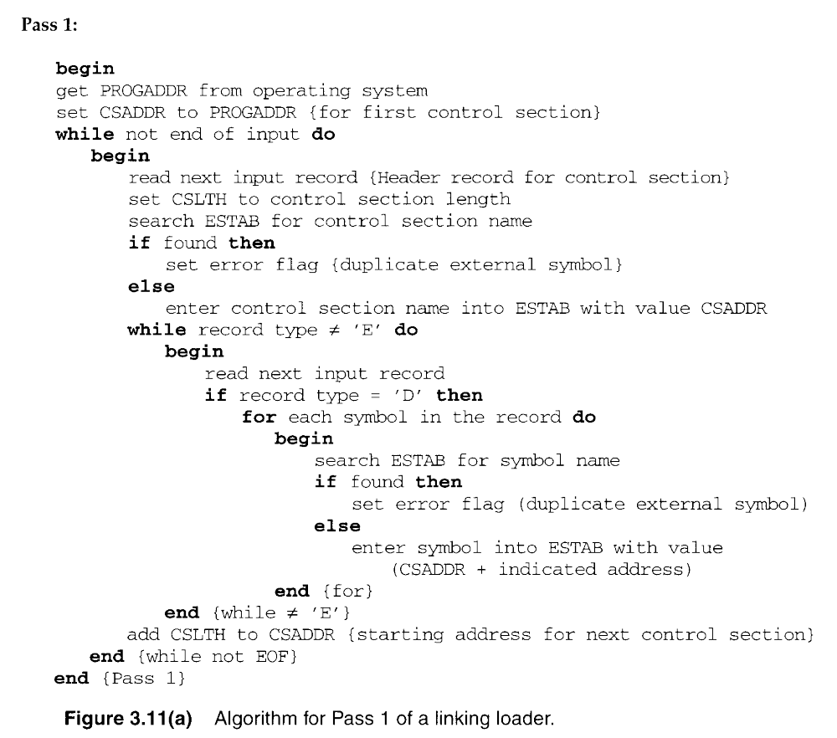

Slide 51
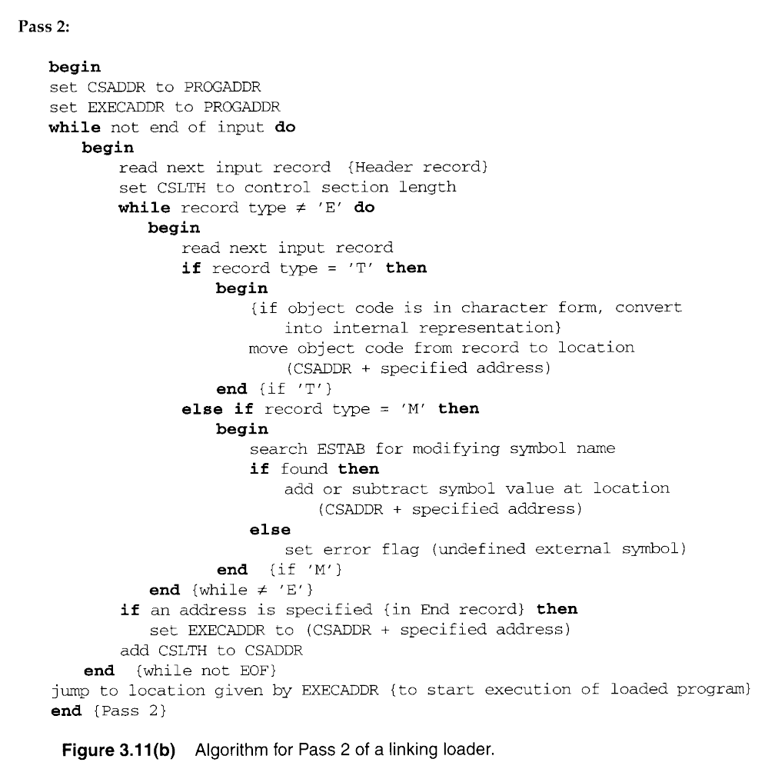

Slide 52
3.2.3 Algorithm and Data Structure for a Linking Loader
The algorithm can be made more efficient.
  A reference number, is used in Modification records.
  The number 01 to the control section name.
  Figure 3.12, the main advantage of this reference-number mechanism is that it avoids multiple searches of ESTAB for the same symbol during the loading of a control section.

Slide 53
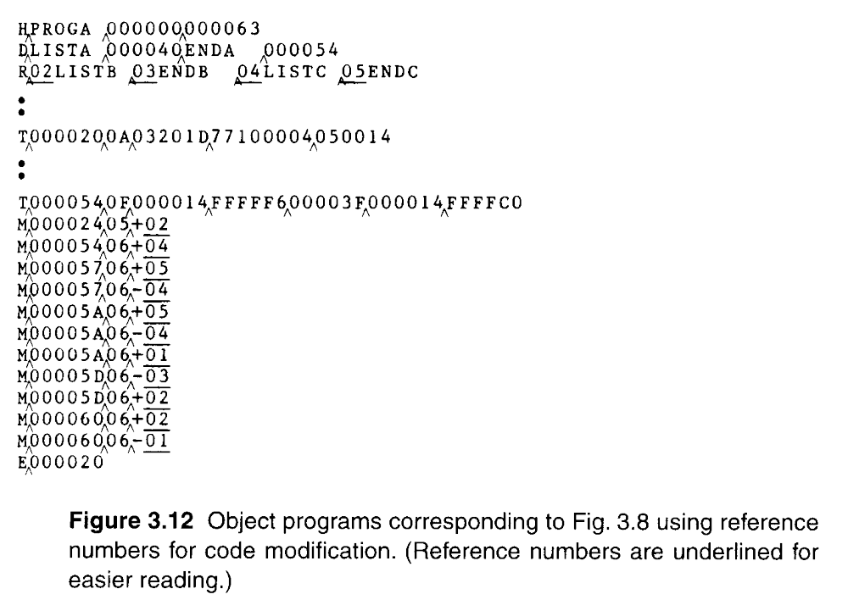

Slide 54
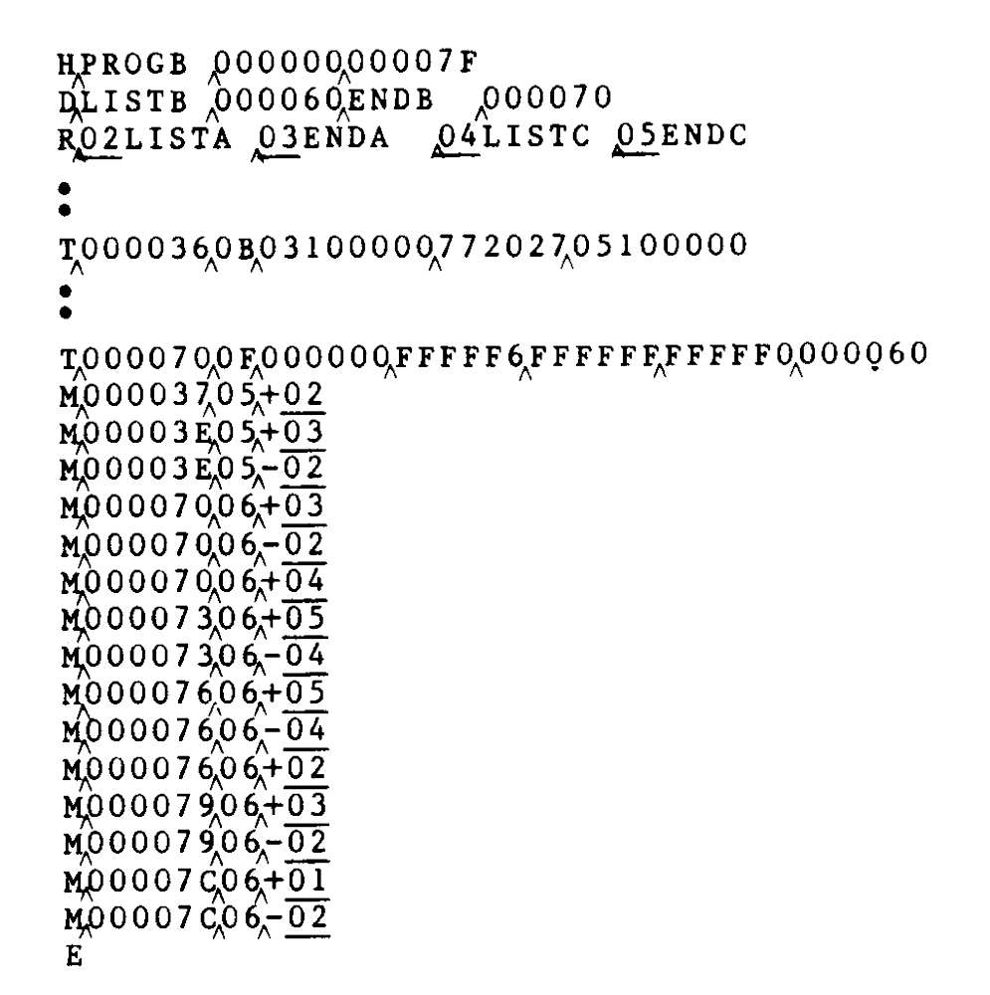

Slide 55
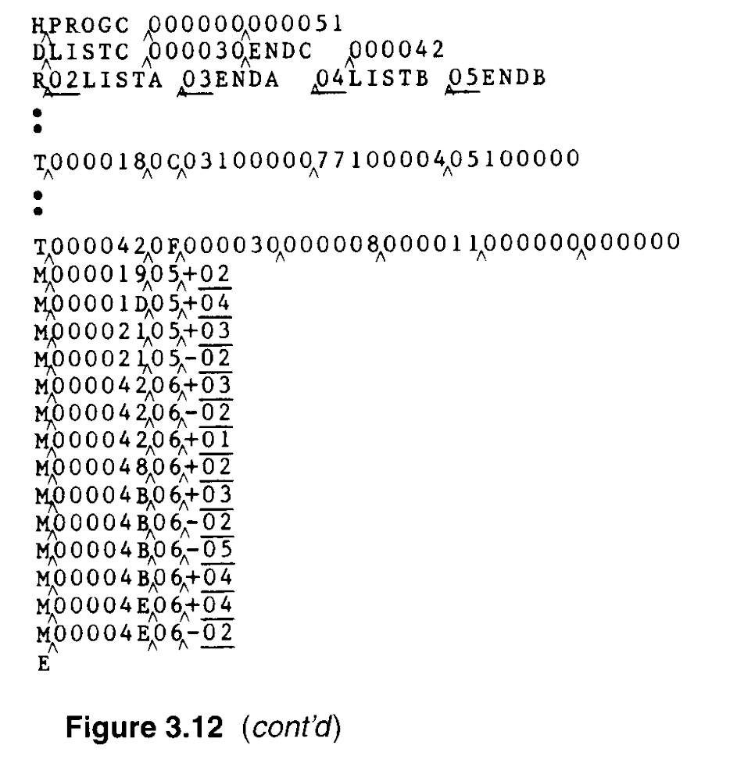

Slide 56
3.3 Machine-Independent Loader Features
3.3.1 Automatic Library Search
Many linking loaders
  Can automatically incorporate routines form a subprogram library into the program being loaded.
  A standard system library
  The subroutines called by the program begin loaded are automatically fetched from the library, linked with the main program, and loaded.

Slide 57
3.3.1 Automatic Library Search
Automatic library call
  At the end of Pass 1, the symbols in ESTAB that remain undefined represent unresolved external references.
  The loader searches the library

Slide 58
3.3.2 Loader Options
Many loaders allow the user to specify options that modify the standard processing.
  Special command
  Separate file
  INCLUDE program-name(library-name)
  DELETE csect-name
  CHANGE name1, name2
    INCLUDE READ(UTLIB)
    INCLUDE WRITE(UTLIB)
    DELETE RDREC, WRREC
    CHANGE RDREC, READ
    CHANGE WRREC, WRITE
    LIBRARY MYLIB
    NOCALL STDEV, PLOT, CORREL

Slide 59
3.4 Loader Design Options
3.4.1 Linkage Editors
Fig 3.13 shows the difference between linking loader and linkage editor.
  The source program is first assembled or compiled, producing an OP.
Linking loader
  A linking loader performs all linking and relocation operations, including automatic library search if specified, and loads the linked program directly into memory for execution.

Slide 60
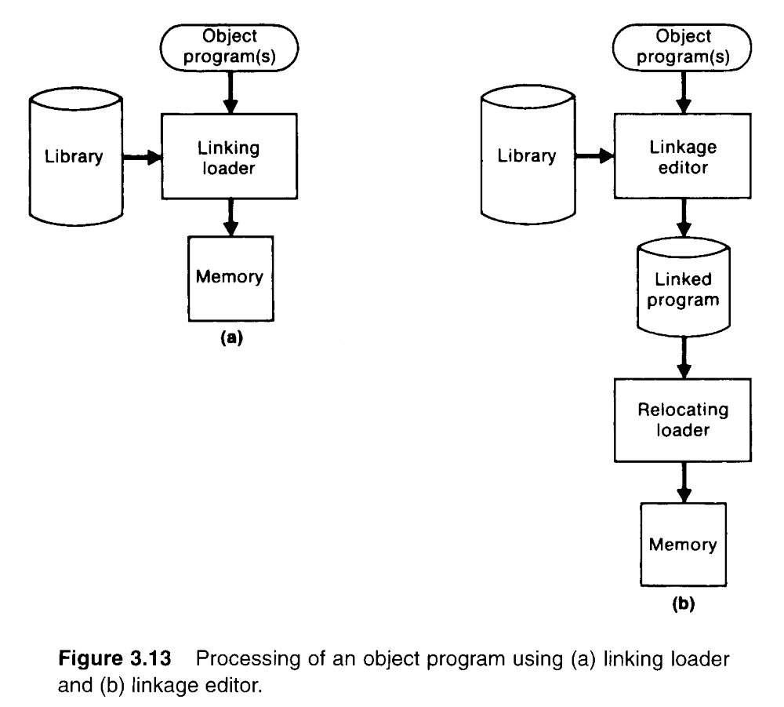
The essential difference between a linkage editor and a linking loader

Slide 61
3.4.1 Linkage Editors
Linkage editor
  A linkage editor produces a linked version of the program (load module or executable image), which is written to a file or library for later execution.
  When the user is ready to run the linked program, a simple relocating loader can be used to load the program into memory.
  The only object code modification necessary is the addition of an actual load address to relative values within the program.
  The LE performs relocation of all control sections relative to the start of the linked program.

Slide 62
3.4.1 Linkage Editors
  All items that need to be modified at load time have values that are relative to the start of the linked program.
  If a program is to be executed many times without being reassembled, the use of a LE substantially reduces the overhead required.
  LE can perform many useful functions besides simply preparing an OP for execution.

Slide 63
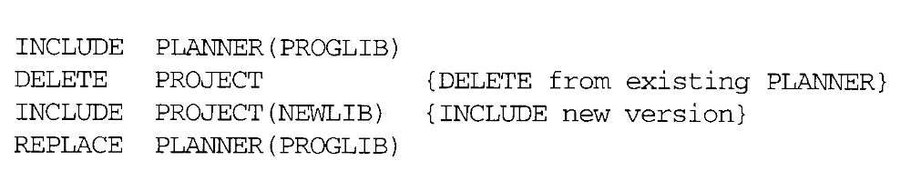
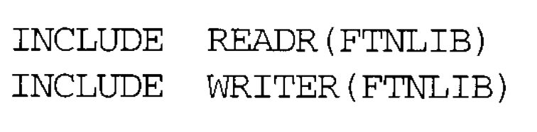
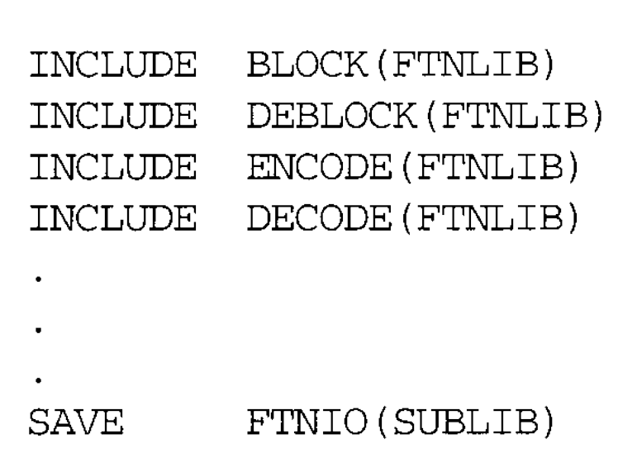

Slide 64
3.4.2 Dynamic Linking
Linking loaders perform these same operations at load time.
Linkage editors perform linking operations before the program is load for execution.

Slide 65
3.4.2 Dynamic Linking
Dynamic linking (dynamic loading, load on call)
  Postpones the linking function until execution time.
  A subroutine is loaded and linked to the rest the program when is first loaded.
  Dynamic linking is often used to allow several executing program to share one copy of a subroutine or library.
    Run-time library (C language), dynamic link library
    A single copy of the routines in this library could be loaded into the memory of the computer.

Slide 66
3.4.2 Dynamic Linking
Dynamic linking provides the ability to load the routines only when (and if) they are needed.
  For example, that a program contains subroutines that correct or clearly diagnose error in the input data during execution.
  If such error are rare, the correction and diagnostic routines may not be used at all during most execution of the program.
  However, if the program were completely linked before execution, these subroutines need to be loaded and linked every time.

Slide 67
3.4.2 Dynamic Linking
Dynamic linking avoids the necessity of loading the entire library for each execution.
Fig. 3.14 illustrates a method in which routines that are to be dynamically loaded must be called via an operating system (OS) service request.

Slide 68
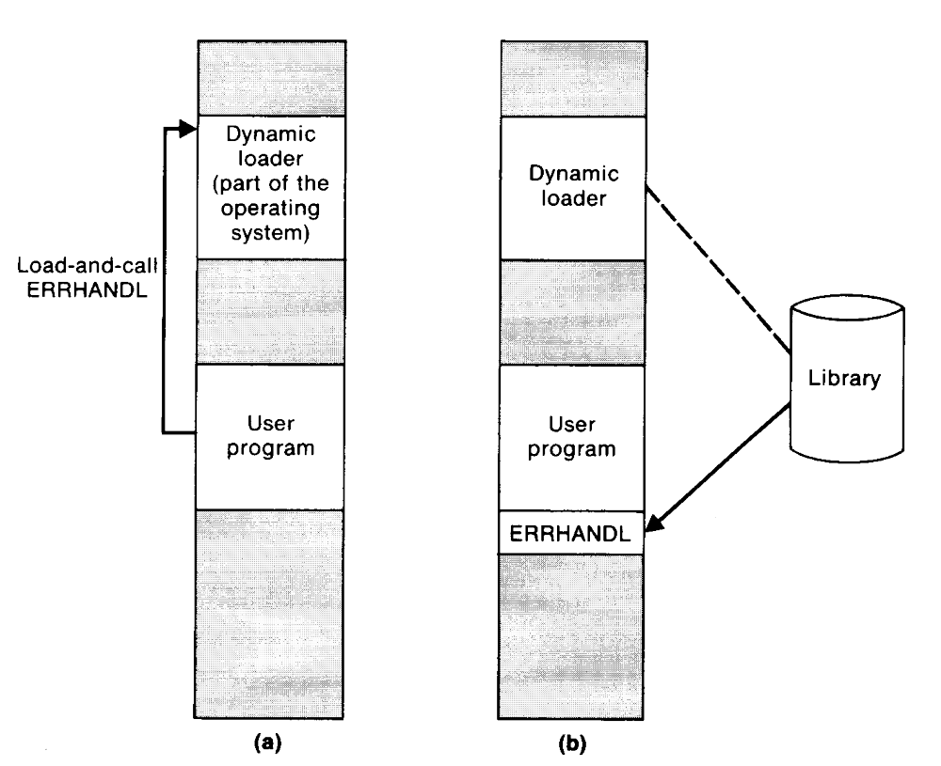

Slide 69
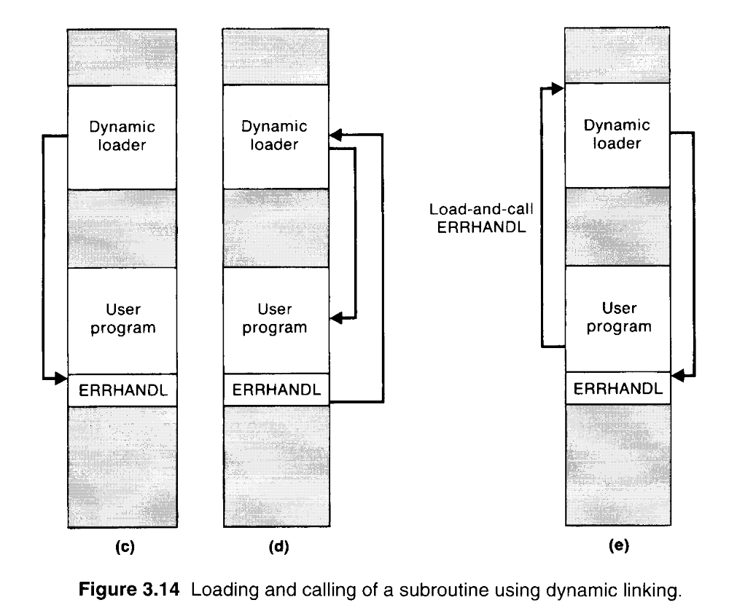

Slide 70
3.4.2 Dynamic Linking
The program makes a load-on-call service request to OS. The parameter of this request is the symbolic name of the routine to be loaded.
OS examines its internal tables to determine whether or not the routine is already loaded. If necessary, the routine is loaded form the specified user or system libraries.
Control id then passed form OS to the routine being called.
When the called subroutine completes its processing, OS then returns control to the program that issued the request.
If a subroutine is still in memory, a second call to it may not require another load operation.

Slide 71
3.4.3 Bootstrap Loaders
An absolute loader program is permanently resident in a read-only memory (ROM)
  Hardware signal occurs
The program is executed directly in the ROM
The program is copied from ROM to main memory and executed there.

Slide 72
3.4.3 Bootstrap Loaders
Bootstrap and bootstrap loader
  Reads a fixed-length record form some device into memory at a fixed location.
  After the read operation is complete, control is automatically transferred to the address in memory.
  If the loading process requires more instructions than can be read in a single record, this first record causes the reading of others, and these in turn can cause the reading of more records.

